Slide 1


Background
ZI Conference Round Table:
Using ZI/MI agents in experimental economics
Kevin A. McCabe
Professor of Economics, Law, and Neuroscience
George Mason University
kmccabe@gmu.edu

Slide 2
C^{EE}LAB Research Model – Steps 1 and 2
1. Build a Working Narrative of the Economics Problem
2. Design, Build, and Test a Computational Microeconomic System (MES)
Build Narrative of MES
Build Sequential Runner for MES (Python)
Design and Build Environment and Institution (Python Classes)
State Space
Message Space
Sequence Diagram
Message Driven Computations
Data File Handling
Build Test Agents
Build ZI Strategies for Agents
Test Microeconomic System Using Test Agents and ZI Agents
Pragmatic Use

Slide 3
C^{EE}LAB Research Model – Step 3
Build Performance Function for MES
Benefits of strategy ρ^{k}:
B^{k}(ρ^{k}| ρ^{-k}) = V^{k}(S_{t+1}) - V^{k}(S_{t}) in cardinal units
Note: ρ = (ρ¹, …, ρ^{k} , …, ρ^{N}) = (ρ^{k}| ρ^{-k})
ρ^{-k} = (ρ¹, …, ρ^{k-1} , ρ^{k+1} , …, ρ^{N})
Costs of strategy:
C^{k}(ρ^{k}| ρ^{-k}) = c^{k}(ρ^{k}) + c(ρ) in same cardinal units as B^{k}
c^{k}(ρ^{k}) = individual cost (cognitive, embodied)
c(ρ) = institutional cost (algorithmic, technology) (Agents charged fee)
We see ZI traders as using ρ^{ZI} minimizing c^{k}(ρ^{k}).
Institutions can reduce the computational burden of agents and may do this
using returns to scale technologies lowering fees charged. DA limit vs market orders.
Theory Use

Slide 4
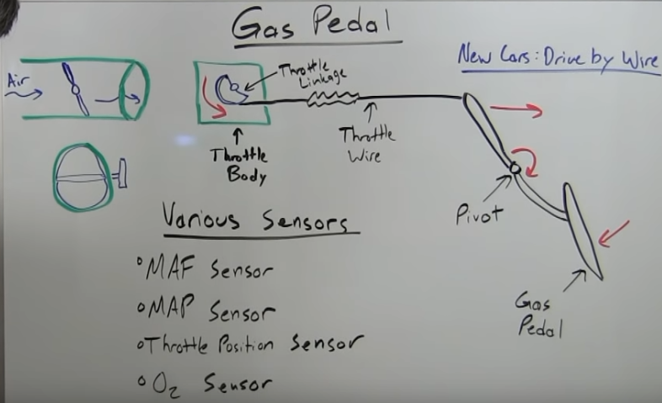
How implicit imperative knowledge works?
m
Message Request
Messages
Base
Algorithm
High Level
Algorithm
Lower
Level
Algorithm
Message - Feedback
m
Messages
Base
Algorithm
Message Event
Lower
Level
Algorithm
c^{k}(ρ^{k}) = individual cost
= cost of deciding on request
= cost of processing feedback
See: https://www.youtube.com/watch?v=smI2ijg4KcM

Slide 5
Decomposition of Governance Rules
STATE of WORLD (s)
Institution
Message Space
Message Rules
Technology
Algorithm
STATE
Process
Validity
Order
Discard

Slide 6
Organizations Own/Manage Institutions
Organization
Decision
Makers
State of Organization (z)
Rights: Who has what roles.
STATE
STATE
STATE
Governance
Institutions
Production
Institutions
Entrance
Institutions
STATE of WORLD (s)

Slide 7
C^{EE}LAB Research Model – Steps 4, 5, 6
Build Concurrent Runner for MES (Actor Model -> Thespian -> mTree)
Usually requires some refactoring of Python code
Build Theory Cognition Models for Agents
Optimization and Equilibrium: Theory
Cognitive Psychology: Perception, Attention, Memory,
Goal Direct Learning, Beliefs, Strategy Formation
Neural Models: Biophysical (Note: energy constant almost
constant. Processing cost moves from relatively low to infinite. Attention is high opportunity cost.)
Simulate Microeconomic System:
Increasing intelligence of agents with increasing costs
Increasing cost of institution with increasing fees
Determine both optimal tradeoff and dynamics of behavior and
performance.

Slide 8
C^{EE}LAB Research Model – Steps 7, 8, 9
Design and Run Experiment
Calibrate Control Variables
Build Subject Interface (Flask and related)
Build Config for Statistical Design
Recruit and Manage Subjects and Subject Pool
Collect and Analyze Data
Improve Agent Models Based on Experimental Data
Provide policy analysis:
Calibrate to field (may have done this above)
Examine proposals using improved model simulations.
Run competing proposals in the lab.
Run competing proposals in the field.

Slide 9
Thank You

